Slide 1
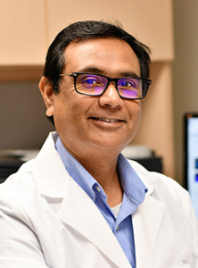
Bifunctional Fusion Cytokine Therapy for Autoimmune Diseases
Rahul Sharma, PhD Associate Professor, Medicine: Nephrology
Dr. Rahul Sharma, Ph.D., Associate Professor, Division of Nephrology-CIIR received research award from the Virginia Catalyst to support IND-enabling research based technology in collaboration with VCU and Virginia Tech.

